Slide 1

Analysis of Daily Power Generation Trends in India
Lissmariya Joy

Slide 2

Introduction:
This project analyzes daily electricity generation data across India from 2017 to 2020 using a large dataset obtained from official Government of India sources. The dataset contains information on regions, states, power sectors, power stations, monitored capacity, planned generation, and actual generation. The objective of the project is to perform data cleaning, handle missing values, detect outliers, and conduct Exploratory Data Analysis (EDA) to identify trends and patterns in power generation. Using Python libraries such as Pandas, NumPy, Matplotlib, and Seaborn, the project visualizes and analyzes electricity generation performance across different regions, states, and sectors, providing insights into generation efficiency, capacity utilization, and overall power generation trends in India.

Slide 3

Problem Statement:
India's electricity generation varies across regions and power stations. Understanding generation patterns is essential for energy planning and decision-making. The project identifies trends, relationships, and performance variations in power generation.
Dataset Description:
Source: India Government Data Portal (https://indiadataportal.com/p/power/r/mop-power_generation-pl-dl-abc)
Original Dataset: 1,048,575 rows and 12 columns
Study Period: 1 September 2017 to 25 October 2020
Final Dataset: 992,442 records after cleaning and filtering with 16 column

Slide 4
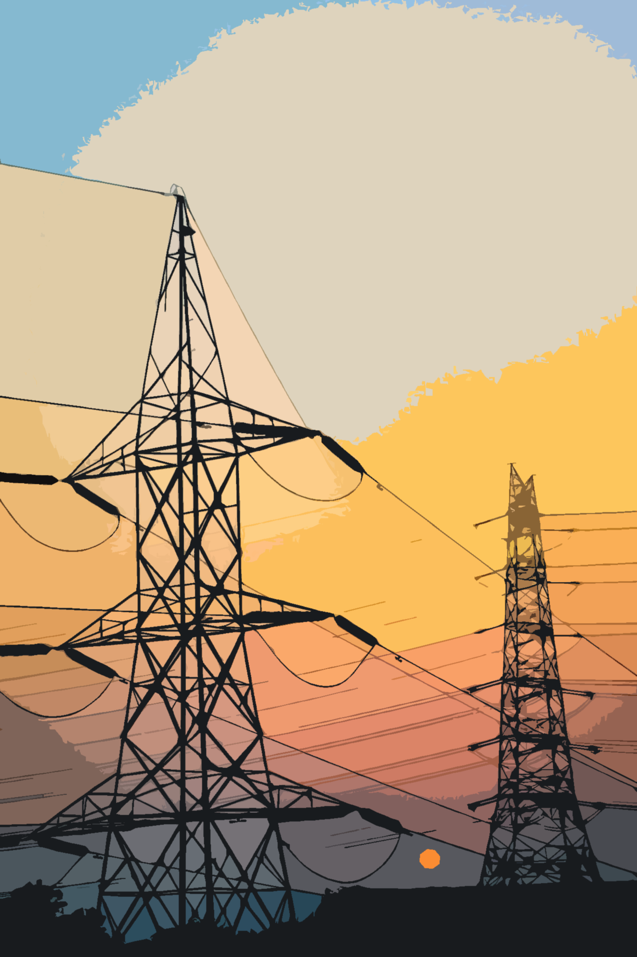
Dataset Attributes:
Id
Date
Region
State Name
State Code
Sector
Station Type
Power Station
Power Station Unit
Monitored Capacity
Today's Generation Planned
Today's Generation Actual
Derived Columns:
Country
Power Source
Generation Status
Year

Slide 5
Technologies Used:
Programming Language:
Python
Libraries:
Pandas
NumPy
Matplotlib
Seaborn
Plotly
Development Environment:
Visual Studio Code (VS Code)

Slide 6
Data Cleaning and Preparation Steps:
Handled missing values and duplicate records.
Converted the Date column to datetime format.
Converted State Code to integer format.
Standardized categorical values in the Station Type column.
Created new derived columns:
Country
Power Source
Generation Status
Year
Retained Bhutan records and classified them as Imported Power.
Filtered records with zero monitored capacity, planned generation, and actual generation values where appropriate.

Slide 7
Exploratory Data Analysis (EDA):
Univariate Analysis:
Analyzed the distribution of numerical variables.
Examined yearly total power generation trends.
Studied region-wise and state-wise power generation.
Evaluated sector-wise and station type contributions.
Analyzed the distribution of actual generation.

Slide 8
Bivariate Analysis:
Compared planned and actual power generation.
Analyzed region-wise and sector-wise power generation.
Studied the relationship between monitored capacity and actual generation.
Calculated the number of power stations across states.
Examined the correlation between planned and actual generation.
Multivariate Analysis:
Performed year-wise station type analysis.
Conducted year-wise region-wise power generation analysis.
Identified top and bottom performing states and power stations.
Analyzed quarterly generation trends.
Performed correlation analysis between monitored capacity, planned generation, and actual generation.

Slide 9
Data Visualization:
Month-wise Total Power Generation (Line Chart)
Year-wise Total Power Generation (Line Chart)
Year-wise Planned vs Actual Generation (Line Plot)
Region-wise Total Generation (Bar Chart)
Top 10 Power Generating States (Bar Chart)
Station Type Contribution (Pie Chart)
Sector-wise Planned vs Actual Generation (Grouped Bar Chart)
Power Source Contribution (Pie Chart)
Correlation Heatmap

Slide 10
Data Visualization (continue):
Distribution of Actual Generation (Histogram)
Box Plot (Outlier Detection)
State-wise Capacity vs Generation (Scatter Plot)
Year-wise Station Type Trend (Stacked Bar Chart)
Quarterly Trend (Line Chart)
Top 10 Performing Power Stations (Bar Chart)
Bottom 5 States with Lowest Power Generation (Bar Chart)

Slide 11
Key Insights:
Conventional Thermal power stations contributed nearly 80% of India's total electricity generation.
Domestic Power accounted for approximately 99% of total generation.
Maharashtra, Uttar Pradesh, Madhya Pradesh, Chhattisgarh, and Gujarat were the leading power-generating states.
Western and Northern regions generated the highest electricity.
All top-performing power stations were Conventional Thermal stations belonging to the Central and Private sectors.
Actual generation closely followed planned generation with a correlation coefficient of 0.74.

Slide 12
Key Insights (Continue):
States with higher monitored capacities generally produced more electricity.
Power generation remained relatively stable during 2018 and 2019, while 2020 exhibited noticeable fluctuations.
Power generation infrastructure and output varied significantly across states and regions.
Goa recorded zero actual generation despite having monitored capacity values, indicating possible missing data or temporarily non-operational stations.

Slide 13
Recommendations:
Strengthen electricity generation infrastructure in low-performing states and regions.
Improve data monitoring and reporting mechanisms.
Continuously monitor the performance of major power stations.
Increase investment in renewable and alternative energy sources.
Conduct further studies on demand forecasting and capacity utilization to support future energy planning.

Slide 14
Conclusion:
The analysis reveals that domestic Conventional Thermal power stations predominantly drove India's electricity generation from 2017 to 2020. Electricity generation was concentrated among a few states and large-capacity power stations, while actual generation generally remained close to planned targets. The findings provide valuable insights into generation trends, regional disparities, and infrastructure performance and can support future energy planning and policy decisions

Slide 15
Q & A

Slide 16
THANK YOU ☺

